Slide 1
EBN 111/122 ELECTRICITY AND ELECTRONICS
Chapter 4
Circuit Theorems

Slide 2
Circuit Theorems - Chapter 4
4.1 Motivation
4.2 Linearity Property
4.3 Superposition
4.4 Source Transformation
4.5 Thevenin’s Theorem
4.6 Norton’s Theorem
4.8 Maximum Power Transfer

Slide 3
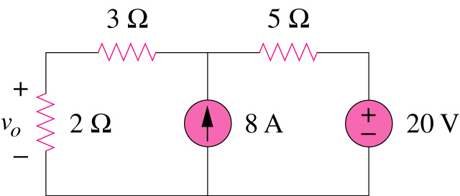
If you are given the following circuit, are there any other alternative(s) to determine the voltage across 2Ω resistor?
4.1 Motivation
What are they? And how?
Can you work it out by inspection?

Slide 4
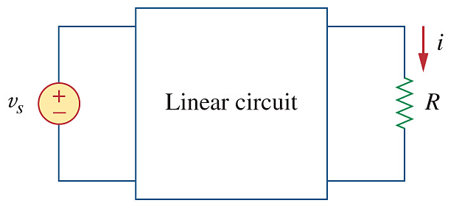
4.2 Linearity Property
It is the property of an element describing a linear relationship between cause and effect.
A linear circuit is one whose output is linearly related (or directly proportional) to its input.
Two properties of linearity
Homogeneity (scaling)
v = i R → k v = k i R
Additivity
v₁ = i₁ R and v₂ = i₂ R
→ v = (i₁ + i₂) R = v₁ + v₂
Assume v_{s} = 10V ⟹ i = 2 A
then: v_{s} = 1V ⟹ i = 0.2 A
v_{s} = 100V ⟹ i = 20 A

Slide 5
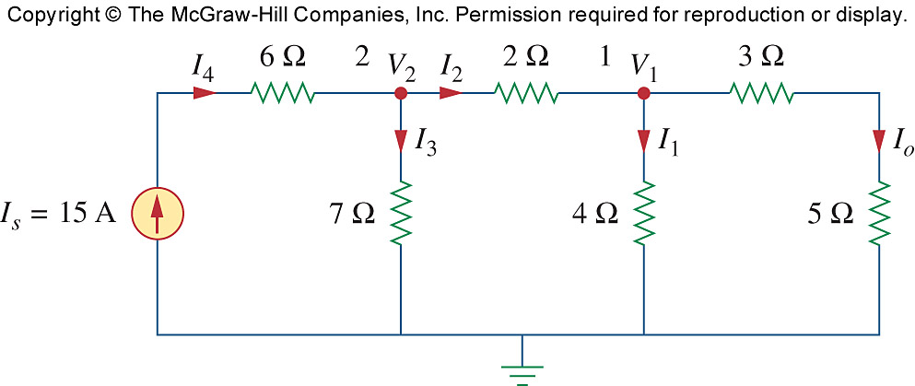
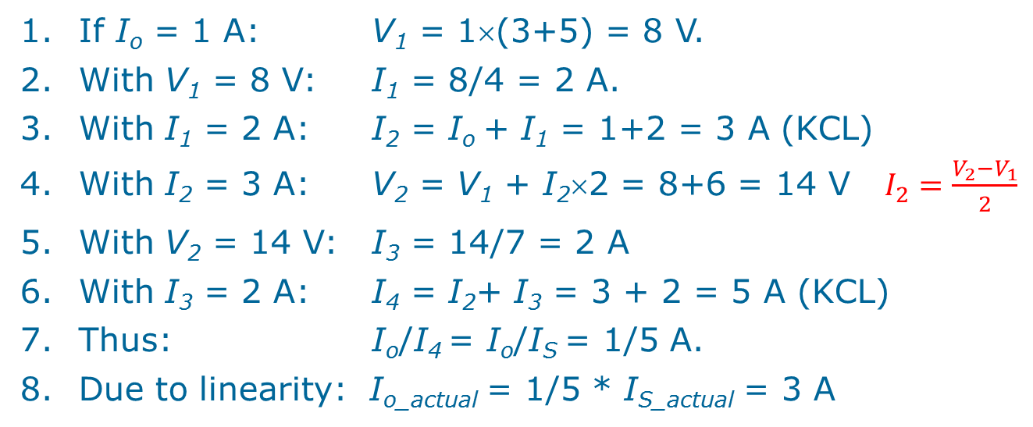
Example 4.2 Assume I_{o} = 1 A and use linearity to find the actual value of I_{o} in the circuit.
If I_{o} = 1 A: V₁ = 1×(3+5) = 8 V.
With V₁ = 8 V: I₁ = 8/4 = 2 A.
With I₁ = 2 A: I₂ = I_{o} + I₁ = 1+2 = 3 A (KCL)
With I₂ = 3 A: V₂ = V₁ + I₂×2 = 8+6 = 14 V $I_{2}=\frac{V_{2}−V_{1}}{2}$
With V₂ = 14 V: I₃ = 14/7 = 2 A
With I₃ = 2 A: I₄ = I₂+ I₃ = 3 + 2 = 5 A (KCL)
Thus: I_{o}/I₄ = I_{o}/I_{S} = 1/5 A.
Due to linearity: I_{o_actual} = 1/5 * I_{S_actual} = 3 A

Slide 6
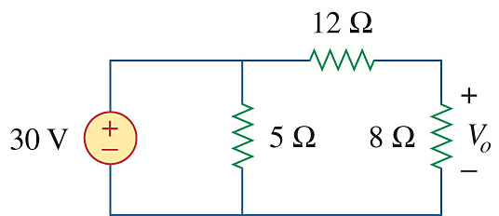
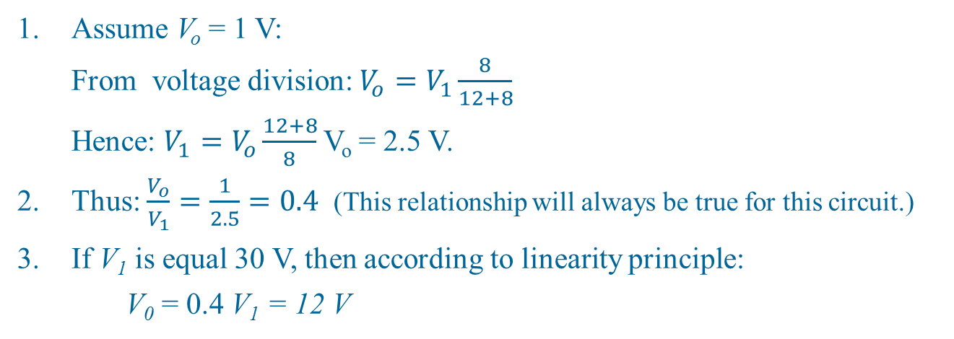
PP 4.2 Assuming V_{o} = 1 V, use linearity to calculate the actual value of V_{o}.
V₁
i
Assume V_{o} = 1 V:
From voltage division: $V_{o}=V_{1}\frac{8}{12+8}$
Hence: $V_{1}=V_{o}\frac{12+8}{8}$V_{o} = 2.5 V.
Thus: $\frac{V_{o}}{V_{1}}=\frac{1}{2.5}=0.4$ (This relationship will always be true for this circuit.)
If V₁ is equal 30 V, then according to linearity principle:
V₀ = 0.4 V₁ = 12 V

Slide 7
4.3 Superposition Theorem
The voltage across (or current through) an element in a linear circuit is the algebraic sum of the voltage across (or currents through) that element due to EACH independent source acting alone.
The principle of superposition helps us to analyze a linear circuit with more than one independent source by calculating the contribution of each independent source separately.

Slide 8
4.3 Superposition Theorem
We consider the effects of 8A and 20V one by one, then add the two effects together for final v_{o}.

Slide 9
4.3 Superposition Theorem STEPS
Steps to apply superposition principle
Turn off all independent sources except one source. Find the output (voltage or current) due to that active source using nodal or mesh analysis.
Repeat step 1 for each of the other independent sources.
Find the total contribution by adding algebraically all the contributions due to the independent sources.

Slide 10
4.3 Superposition Theorem Zeroing of Sources
How do you turn off a source, i.e. make it zero?
Independent sources:
Independent voltage sources are replaced by 0 V (short circuit (R=0 Ω))
Independent current sources are replaced by 0 A (open circuit (R → ∞ Ω)).
Dependent sources are left intact because they are controlled by circuit variables.

Slide 11
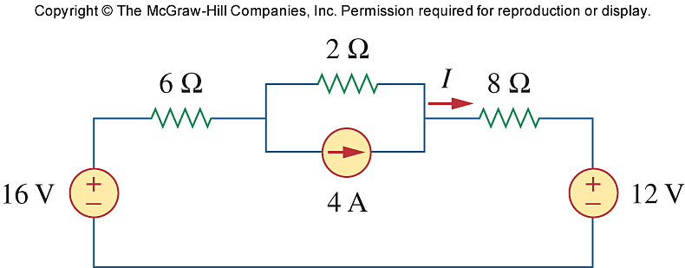
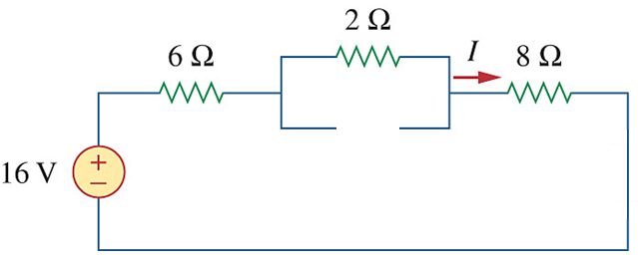
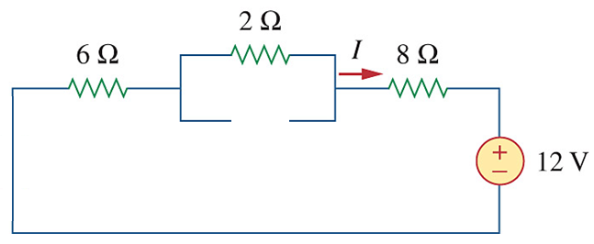
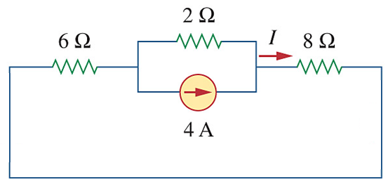
PP 4.5:
Use superposition
to find I.
Switch off the 4 A and 12 V sources:
Switch off the 4 A and 16 V sources:
I₁ = 16/16 = 1 A
I₂ = - 12/16 = -0.75 A
Switch off the 12 V and 16 V sources:
I = I₁ + I₂ + I₃
= 1 + -0.75 + 0.5
= 0.75 A
I₃ = 4× [2 / (2 + 14)] = 0.5 A

Slide 12
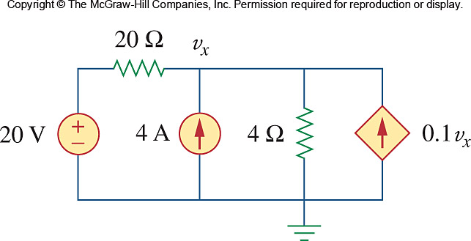
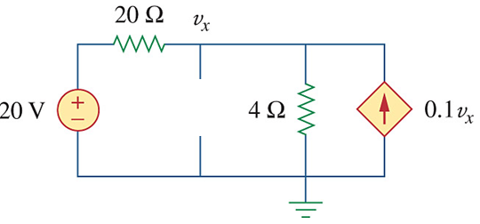
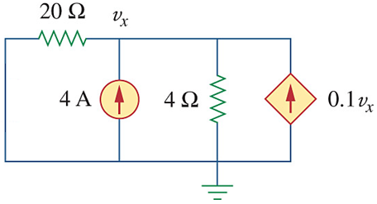
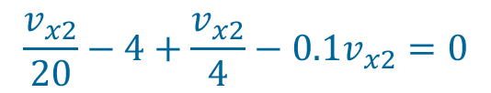


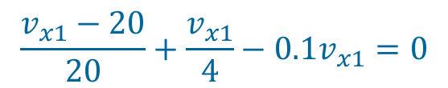


PP 4.4:
Use superposition
to find v_{x}.
Switch off (zero) the 4 A source:
Nodal-analysis:
$$\frac{v_{x1}−20}{20}+\frac{v_{x1}}{4}−0.1v_{x1}=0$$
$$v_{x1}−20+5v_{x1}−2v_{x1}=0$$
$$v_{x1}=5 V$$
Switch off (zero) the 20 V source:
Nodal-analysis:
$$\frac{v_{x2}}{20}−4+\frac{v_{x2}}{4}−0.1v_{x2}=0$$
$$v_{x2}−80+5v_{x2}−2v_{x2}=0$$
$$v_{x2}=20 V$$
Total: v_{x} = v_{x1} + v_{x2} = 5 + 20 = 25 V

Slide 13
Ch. 4 L#2:
4.4 Source Transformations
An equivalent circuit is one whose v-i characteristics are identical with the original circuit.
It is the process of replacing a voltage source V_{S} in series with a resistor R by a current source I_{S} in parallel with a resistor R, or vice versa.

Slide 14
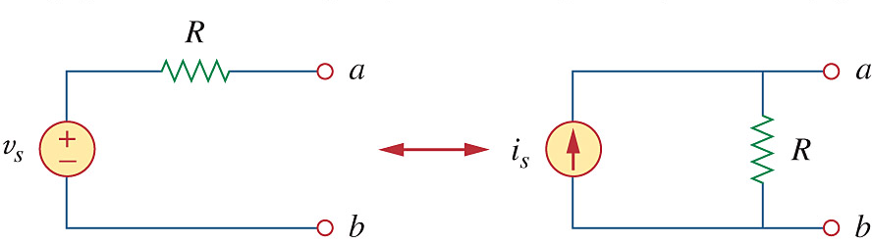
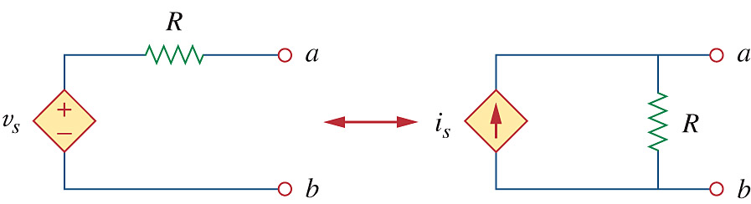


4.4 Source Transformation
+
+
The arrow of the current source is directed toward the positive terminal of the voltage source.
The source transformation is not possible when R = 0 for voltage source and R = ∞ for current source.
$$v_{s}=i_{s}R$$
$$i_{s}=\frac{v_{s}}{R}$$
-
-
(a) Independent source transform
+
+
-
-
(b) Dependent source transform

Slide 15


4.4 Source Transformation From a Load’s perspective
+
+
Load
$$i_{s}=\frac{v_{s}}{R}$$
Load
$$v_{s}=i_{s}R$$
-
-
A load connected between terminals a-b will not know the difference. The load will see the same voltage and conduct the same current.

Slide 16
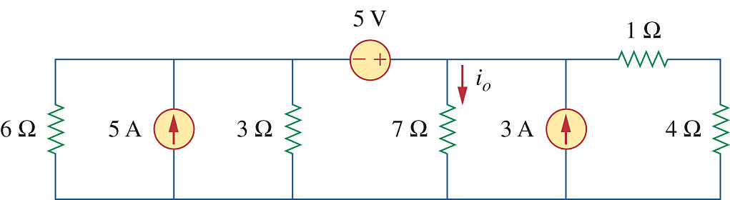
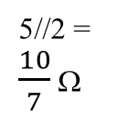
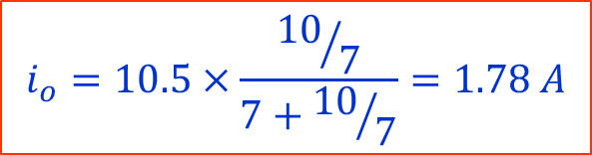
PP 4.5: Use source transformation and determine i_{o}.
5 V
i_{o}
6//3 = 2 Ω
7 Ω
1+4= 5 Ω
i_{o}
5 A
3 A
15/2= 7.5 A
7 Ω
3 A
5 Ω
2 Ω
2 Ω
5 V
i_{o}
i_{o}
5 ⋅ 2 = 10 V
7 Ω
3 A
5 Ω
7.5+3=
10.5 A
5//2 = $\frac{10}{7}$ Ω
7 Ω
2 Ω
i_{o}
$$i_{o}=10.5×\frac{{10}/7}{7+{10}/7}=1.78 A$$
5 + 10 = 15V
7 Ω
3 A
5 Ω

Slide 17


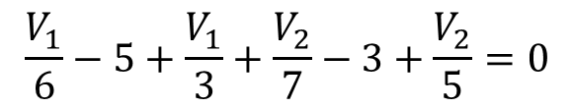
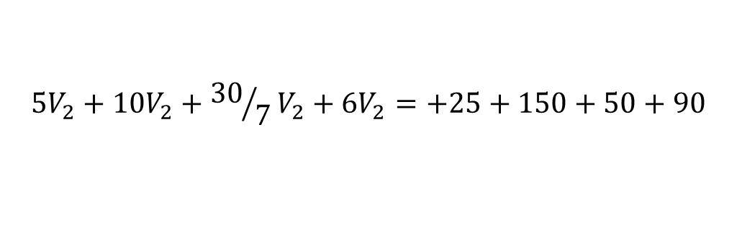
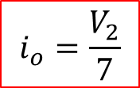
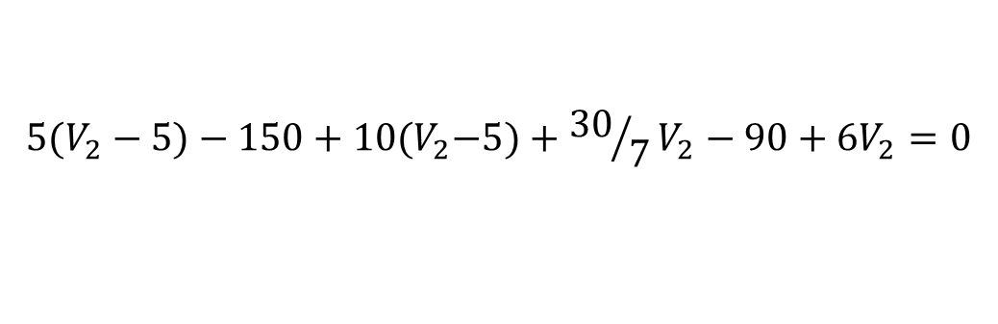

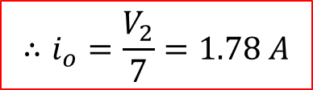


PP 4.5b: Use nodal analysis and determine i_{o}.
V₁
V₂
$$i_{o}=\frac{V_{2}}{7}$$
Supernode:
$$V_{2}−V_{1}=5$$
$$∴V_{1}=V_{2}−5$$
1
KCL @ Supernode:
$$\frac{V_{1}}{6}−5+\frac{V_{1}}{3}+\frac{V_{2}}{7}−3+\frac{V_{2}}{5}=0$$
2
x30
$${5(V}_{2}−5)−150+10{(V}_{2}−5)+{30}/7V_{2}−90+{6V}_{2}=0$$
$${5V}_{2}+10V_{2}+{30}/7V_{2}+{6V}_{2}=+25+150+50+90$$
$$25.286V_{2}=315$$
$$∴V_{2}=12.457 V$$
$$∴i_{o}=\frac{V_{2}}{7}=1.78 A$$

Slide 18
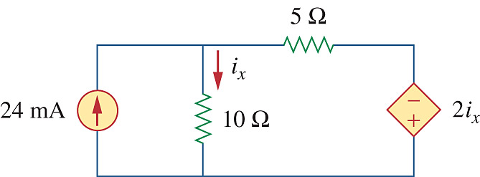
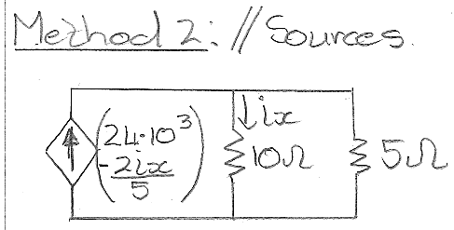
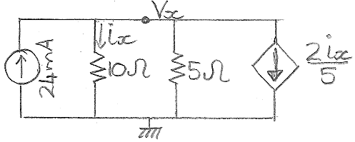

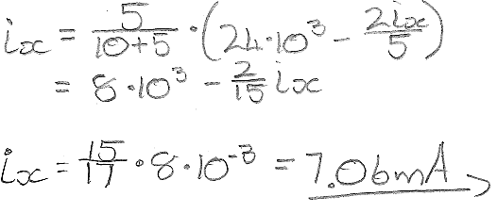
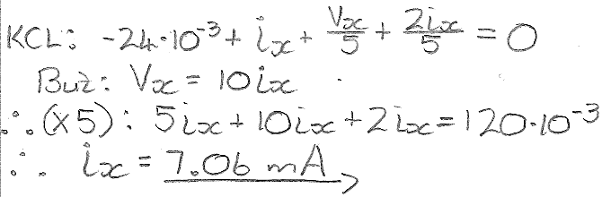
PP 4.7: Use source transformation and determine i_{x}.
Very IMPORTANT:
Do NOT transform the part of the circuit with the unknown variable!

Slide 19
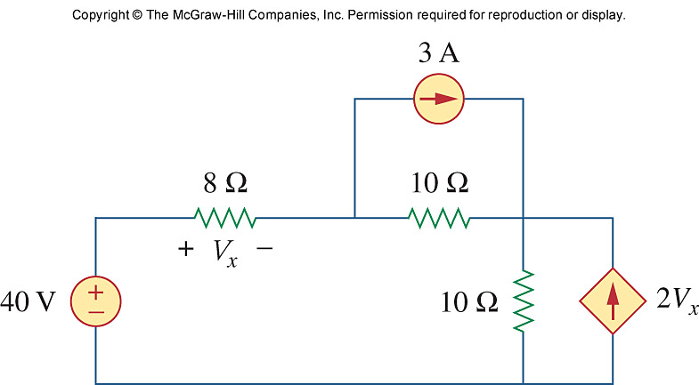
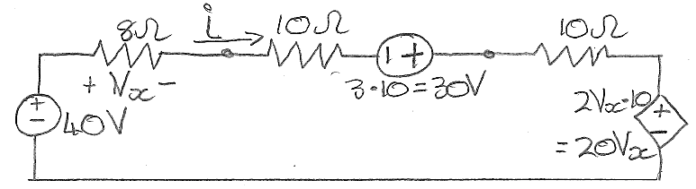
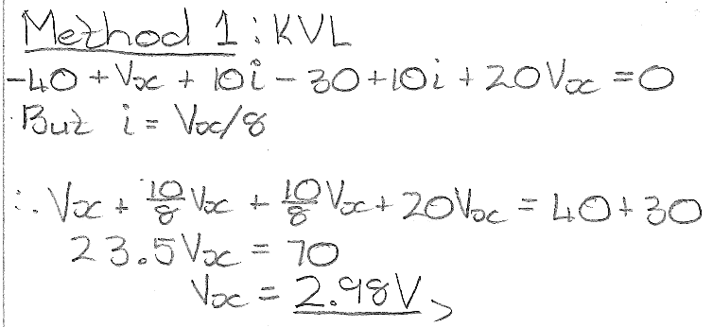
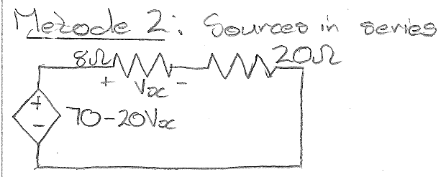
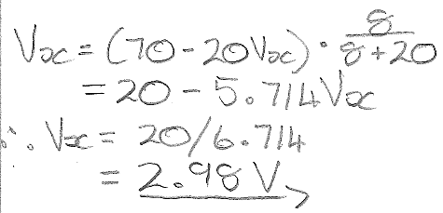
Problem 4.24: Determine v_{x}.

Slide 20
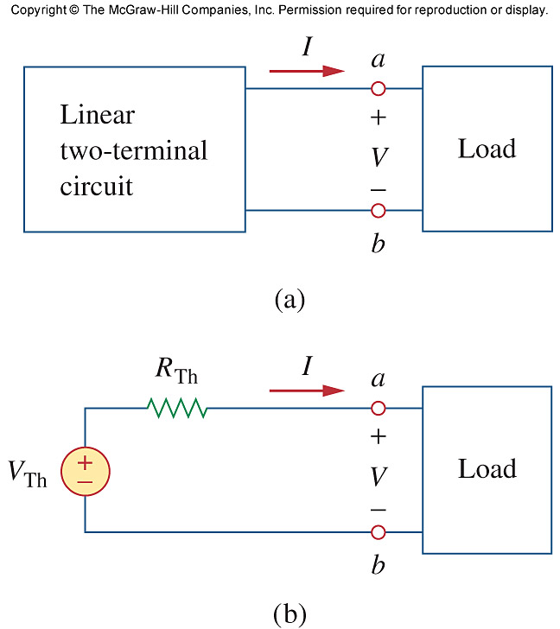
Ch. 4 L#3:
4.5 Thevenin’s Theorem
It states that a linear 2-terminal circuit (Fig. a) can be replaced by an equivalent circuit (Fig. b) consisting of a voltage source V_{TH} in series with a resistor R_{TH},
where
V_{TH} is the open-circuit voltage (V_{oc}) at the terminals.
R_{TH} is the input or equivalent resistance at the terminals when the independent sources are turned off.

Slide 21
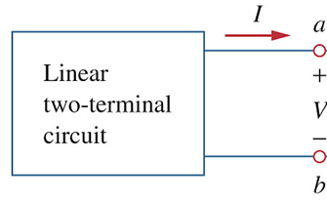
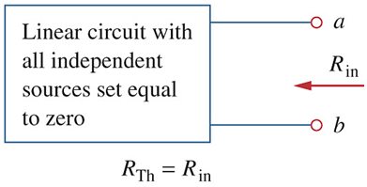
4.5 Thevenin’s Theorem How to determine V_{th} and R_{th}
To determine V_{th}:
V_{oc} = Open Circuit Voltage.
Terminals a-b are terminals between which you want to determine the Thevenin equivalent.
Can be anywhere in the circuit.
V_{oc} = V_{th}
To determine R_{th}:
Method #1:
Zeroing of Sources:
If the circuit contains no dependent sources.

Slide 22
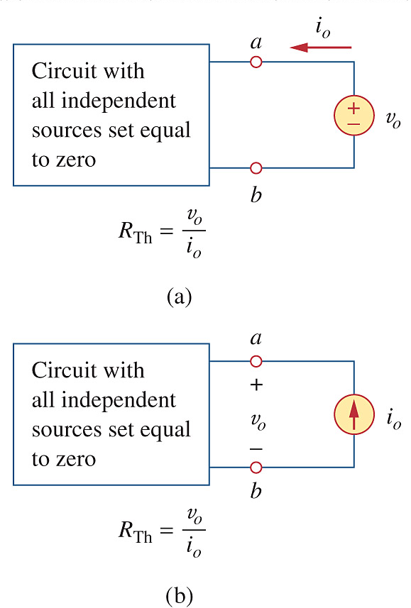
4.5 Thevenin’s Theorem How to determine R_{th} Case 2
Method #2: Application of test sources, if the circuit does contain dependent sources.
Test Sources
MUCHO IMPORTANTE:
You cannot turn off dependent sources as they are controlled by circuit variables.

Slide 23
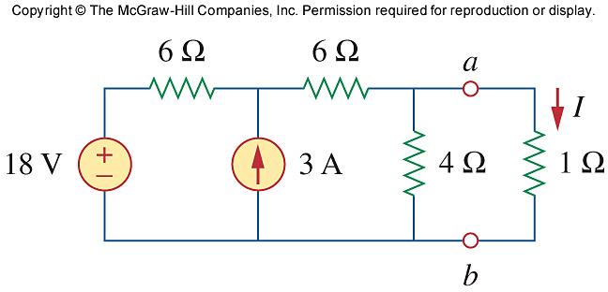
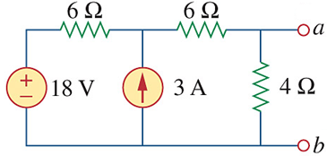
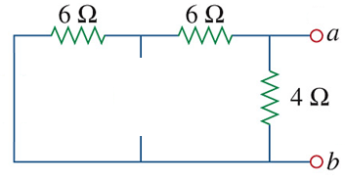

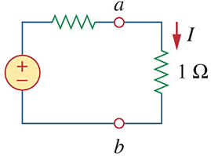

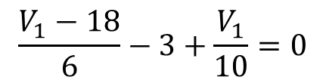

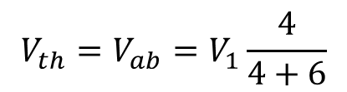
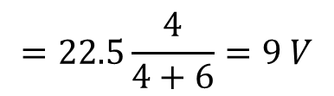
PP 4-8:
Determine the Thevenin equivalent circuit to the left of terminals a-b.
Determine I.
V_{th}: Calculate V_{oc} = V_{ab}:
R_{th}: Zero Ind. Sources:
V₁
$$V_{th}=V_{ab}=V_{1}\frac{4}{4+6}$$
$$=22.5\frac{4}{4+6}=9 V$$
R_{th} = 4//(6+6) = 3 Ω
For I:
$$\frac{V_{1}−18}{6}−3+\frac{V_{1}}{10}=0$$
3 Ω
I = 9/4
=2.25 A
x30:
$${5V}_{1}−90−90+3V_{1}=0$$
9 V
$$V_{1}=22.5 V$$

Slide 24
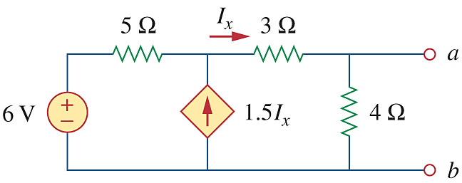

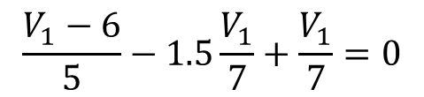

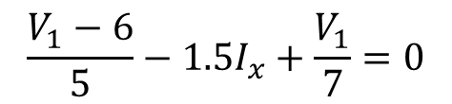



PP 4-9:
Determine the Thevenin equivalent circuit to the left of terminals a-b.
V₁
V_{th}: Calculate V_{oc} = V_{ab}:
$$V_{th}=V_{ab}=V_{1}\frac{4}{4+3}$$
$$=9.\dot{3}\frac{4}{7}=5.\dot{3}V$$
$$\frac{V_{1}−6}{5}−1.5I_{x}+\frac{V_{1}}{7}=0$$
$${But: I}_{x}={V_{1}}/7$$
$$\frac{V_{1}−6}{5}−1.5\frac{V_{1}}{7}+\frac{V_{1}}{7}=0$$
x35:
$${7V}_{1}−42−2.5V_{1}=0$$
$$V_{1}=9.\dot{3} V$$

Slide 25












PP 4-9: continued
R_{th:} Method A
R_{th}: Zero Ind. Sources + CURRENT Test Source: Need V_{ab} = V_{o}
V_{x}
V_{o}
$$\frac{V_{o}−V_{x}}{3}+\frac{V_{o}}{4}−1=0$$
1 A
x12:
$$4\left(V_{o}−V_{x}\right)+3V_{o}=12$$
$$−4V_{x}+7V_{o}=12$$
2
$$\frac{V_{x}}{5}−1.5I_{x}+\frac{V_{x}−V_{o}}{3}=0$$
2
+ 8x :
$$7V_{o}+20V_{o}=12$$
1
$${But: I}_{x}=\frac{V_{x}−V_{o}}{3}$$
$$V_{o}=0.\dot{4} V$$
$$\frac{V_{x}}{5}−1.5\frac{V_{x}−V_{o}}{3}+\frac{V_{x}−V_{o}}{3}=0$$
$$∴R_{th}=\frac{V_{o}}{I_{test}}=\frac{V_{o}}{1}=0.\dot{4} $$
x15:
$$3V_{x}−7.5(V_{x}−V_{o})+5(V_{x}−V_{o})=0$$
$$0.5V_{x}+2.5V_{o}=0$$
1

Slide 26










PP 4-9: continued
R_{th:} Method B
R_{th}: Zero Ind. Sources + VOLTAGE Test Source: Need i_{o}
V_{x}
i_{o}
KCL:
$$\frac{V_{x}−1}{3}+i_{o}−\frac{1}{4}=0$$
x12:
$$4\left(−6\right)+12i_{o}−3=0$$
$$\frac{V_{x}}{5}−1.5I_{x}+\frac{V_{x}−1}{3}=0$$
$$i_{o}=2.25 A$$
$${But: I}_{x}=\frac{V_{x}−1}{3}$$
$$∴R_{th}=\frac{V_{test}}{i_{o}}=\frac{1}{2.25}=0.\dot{4} $$
$$\frac{V_{x}}{5}−1.5\frac{V_{x}−1}{3}+\frac{V_{x}−1}{3}=0$$
x15:
$$3V_{x}−7.5(V_{x}−1)+5(V_{x}−1)=0$$
$$0.5V_{x}+2.5=0 ∴V_{x}=−5 V$$

Slide 27


Problem 4-39:
Determine the Thevenin equivalent circuit.
i₂
- V₁₆ +
+
V_{ab}
_
V_{th}: Calculate V_{oc} = V_{ab}
V_{ab} = V₅ + V₁₆:
i₁
+
V₅
_
Loop 2: i₂ = -1 A
Loop 1:
-8 + 10i₁ +10(i₁ – i₂) + 5i₁ = 0
25i₁ = -2
i₁ = -0.08 A
R_{th}: Zero Ind. Sources:
V_{th} = V₅ + V₁₆
= 5i₁ + 16i₂
= 5(-0.08) + 16(-1)
= -16.4 V
R_{th} = 16+ 5//(10+10)
= 20 Ω

Slide 28

Ch. 4 L#4:
4.6 Norton’s Theorem
It states that a linear two-terminal circuit can be replaced by an equivalent circuit of a current source I_{N} in parallel with a resistor R_{N},
Where
I_{N} is the short circuit current through
the terminals.
R_{N} is the input or equivalent resistance
at the terminals when the independent
sources are turned off.

Slide 29

4.6 Norton’s Theorem Norton vs Thevenin
Norton equivalent = Source transformation of the Thevenin equivalent and vice versa.
Where:
R_{N} = R_{th}
I_{N} = V_{th}/R_{th} = V_{th}/R_{N}
V_{th} = I_{N}R_{th} = I_{N}R_{N}

Slide 30

4.6 Norton’s Theorem How to determine I_{N} and R_{N}
To determine I_{N}:
i_{sc} = short circuit current.
Terminals a-b are terminals between which you want to determine the Norton equivalent.
Can be anywhere in the circuit.
To determine R_{N}:
Methods #1 and #2 as with R_{th} since R_{N} = R_{th.}
Method #3:
Not in this textbook, but you will find it in other.
Short circuit terminals a-b & do not zero any sources.
R_{N} = R_{th} = V_{oc} / i_{sc}
Works for circuits with or without dependent sources.

Slide 31



PP 4-11:
Determine the Norton equivalent circuit to the left of terminals a-b.
I_{N}: Calculate i_{sc} = I_{N}:
R_{N}: Method #1
Only independent sources: Zero them.
i_{sc}
R_{N} = 6//(3+3) = 3 Ω
i_{sc}
Hence 9 A splitting between two 3 Ω resistors:
I_{N} = 9/2 = 4.5 A

Slide 32






PP 4-12:
Determine the Norton equivalent circuit.
I_{N}: Calculate i_{sc} = I_{N}:
R_{N}: Method #2:
Zero Ind. Sources + Test Source
i_{sc}
(1+2) V
1 V
i_{o}
Observe: SC makes v_{x} = 0 V and hence also 2v_{x} = 0.
i_{sc}
KCL @ 1 V node:
$$i_{o}=i_{2}+i_{6}$$
$$i_{o}=\frac{1}{2}+\frac{1+2}{6}=\frac{1}{2}+\frac{1}{2}=1 A$$
6 Ω shorted, hence no current through the 6 Ω:
i_{sc} = 10 A
$$R_{N}=\frac{V_{test}}{i_{o}}=\frac{1}{1}=1 $$

Slide 33





PP 4-12:
Determine the Norton equivalent circuit.
I_{N}: Calculate i_{sc} = I_{N}:
R_{N}: Method #3: R_{th} = V_{oc}/i_{sc}
Find V_{oc}=V_{ab}
i_{sc}
60 V
Observe: SC makes v_{x} = 0 V and hence also 2v_{x} = 0.
i
60 V
Ito current flowing, all elements are now
in series, use Voltage Div to get v_{x}:
i_{sc}
$$v_{x}=\frac{2}{2+6}\left(60−2v_{x}\right)$$
6 Ω shorted, hence no current through the 6 Ω:
i_{sc} = 10 A
$$v_{x}=v_{oc}=V_{th}=10 V$$
$$R_{N}=R_{th}=\frac{v_{oc}}{i_{sc}}=1 $$

Slide 34








Problem 4-51:
Determine the Norton equivalent circuit between terminals a-b.
I_{N}: Calculate i_{sc} = I_{N}:
Method #1: Nodal Analysis
i_{sc}
KCL at big node:
$$\frac{V_{1}−120}{6}+\frac{V_{1}}{3}−6+\frac{V_{1}}{2}=0$$
$$V_{1}−120+2V_{1}−36+3V_{1}=0$$
i_{sc}
$$V_{1}=26 V$$
V₁
KCL at node b:
$$−i_{sc}−6+\frac{V_{1}}{2}=0$$
$$i_{sc}=I_{N}=−6+\frac{26}{2}=7 A$$

Slide 35


Problem 4-51:
Determine the Norton equivalent circuit between terminals a-b.
I_{N}: Calculate i_{sc} = I_{N}:
Method #2: Source Transformations
i_{sc}
i_{sc}
6//3 = 2 Ω
2 Ω
40 V
12 V
i_{sc}
20 A
All in series:
i_{sc} = (40 – 12)/(2+2) = 7 A

Slide 36


Problem 4-51:
Determine the Norton equivalent circuit between terminals a-b.
R_{N}: Method #1:
Zero Ind. Sources
R_{ab} = 4 // (6//3+2)
= 4 // (2+2)
= 4 // 4
= 2 Ω

Slide 37



Ch. 4 L#5:
4.8 Maximum Power Transfer
If the entire circuit is replaced by its Thevenin equivalent except for the load, the power delivered to the load is:
For maximum power dissipated in R_{L}, P_{max}, for a given R_{TH} and V_{TH}:
$$R_{L}=R_{th} → P_{max}=\frac{V_{th}^{}2}{4R_{th}}=\frac{V_{RL}^{}2}{R_{th}}$$
The power transfer profile with different R_{L}

Slide 38






Ex 4-13:
Determine R_{L} for maximum power transfer as well as what P_{max} will be.
Method: Determine the Thevenin circuit between a-b. I.e. V_{th} and R_{th}.
V_{th}: Super positioning:
+
V_{th1}
-
R_{th}: Zeroing of sources:
V_{th1} = 12 V ×12/(6+12) = 8 V
+
V_{th2}
-
R_{th} = 6//12 + 3 + 2 = 9 Ω = R_{L}
9 Ω
V_{th2} = 2A × ((6//12) + 3)
= 2 × 7 = 14 V
∴V_{th} = 8 + 14 = 22V
$$P_{max}=\frac{{22}^{2}}{4×9}=13.44 W$$
9 Ω

Slide 39

















PP 4-13:
Determine R_{L} for maximum power transfer as well as what P_{max} will be.
R_{th}: Method #2:
V
i_{o}
V
V_{th}:
+
V_{th}
-
$$\frac{V}{2}+\frac{V−3v_{x}}{1}+\frac{V−1}{4}=0$$
v_{x} = -V
$$\frac{V−9}{2}+\frac{V−3v_{x}}{1}=0$$
v_{x} = 9$−$V
x4:
$$2V+4\left(V−3\left(−V\right)\right)+(V−1) =0$$
$$\frac{V−9}{2}+\frac{V−3(9−V)}{1}=0$$
$$2V+16V+V =1$$
$$P_{max}=\frac{7^{2}}{4×4.\dot{2}}$$
$=2.901 W$
$$V =1/{19}$$
$$V−9+2\left(V−27+3V\right) =0$$
$$i_{o}=\frac{1−V}{4}=0.237 A$$
$$V+2V+6V =9+54$$
$$V =V_{th}={63}/9=7 V$$
$$R_{th}=R_{L}={v_{test}}/{i_{o}}=4.\dot{2} $$

Slide 40






Problem 4.66:
Determine the maximum power that can be delivered to resistor R.
R_{th}: Method #1:
+ V_{th} -
i
i = 60 / 10 = 6 A
V_{th} = 2i – 10 = 12 – 10 = 2 V
$$P_{max}=\frac{2^{2}}{4×1.6 }$$
$=0.625 W$
R_{th} = 2 // (3+5)
= 1.6 Ω

